Slide 1
Screen Space Ambient Occlusion (SSAO)
Advanced Graphics Programming

Slide 2
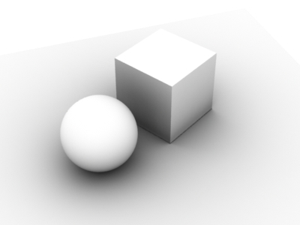
Definition
It’s a shading technique used to compute how much a point in the scene is exposed to ambient lighting.
Very exposed to light
Less exposed to light

Slide 3
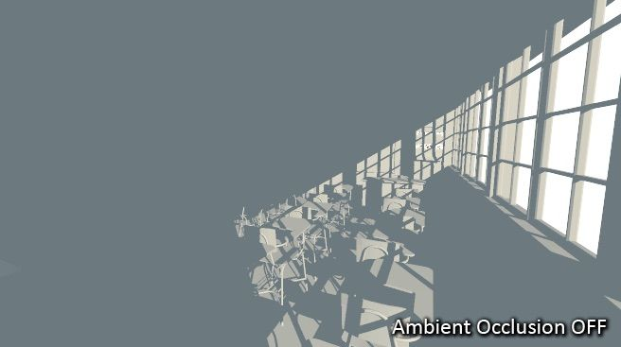
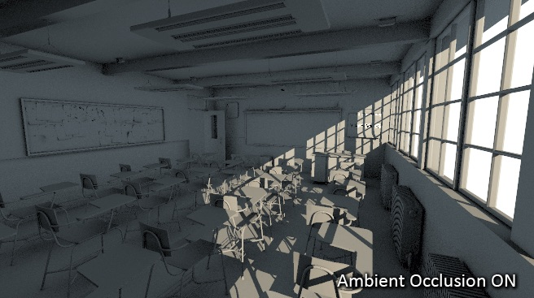
Increases realism!

Slide 4
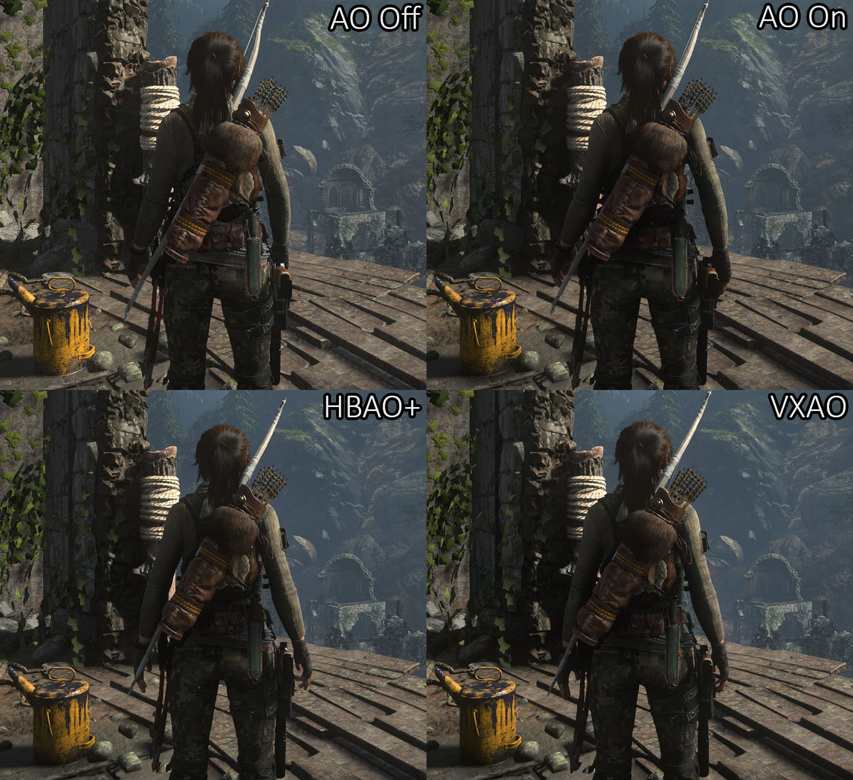
Examples

Slide 5
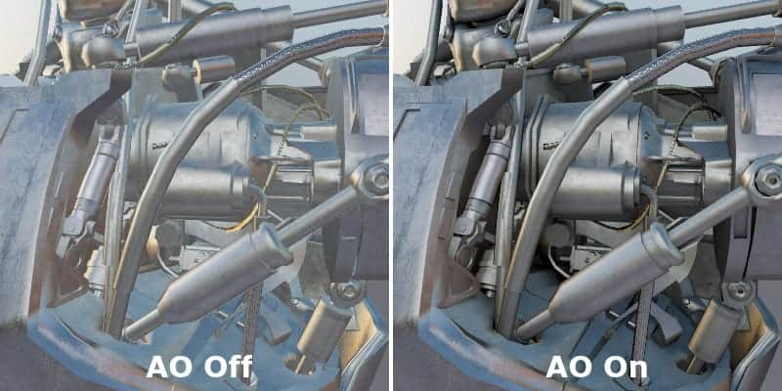
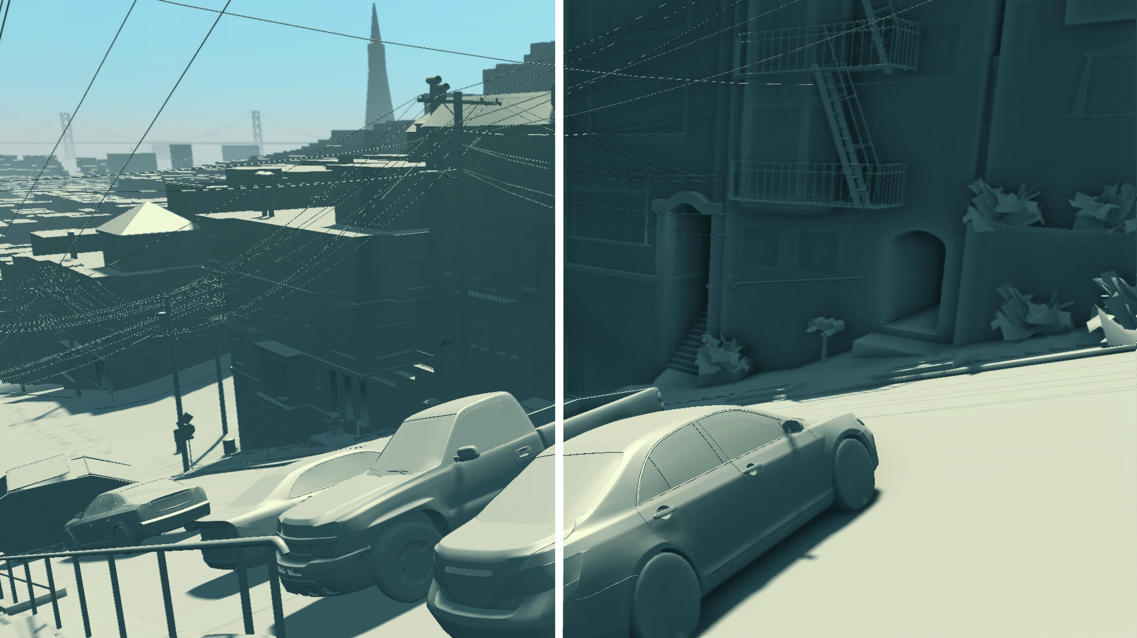
Examples
AO Off AO On

Slide 6
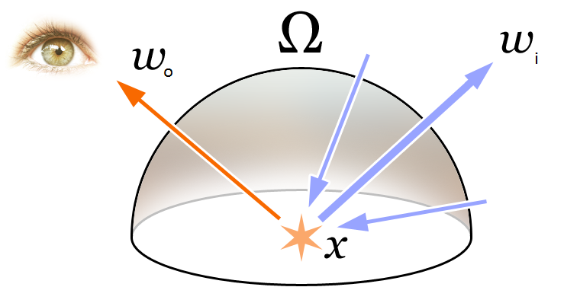
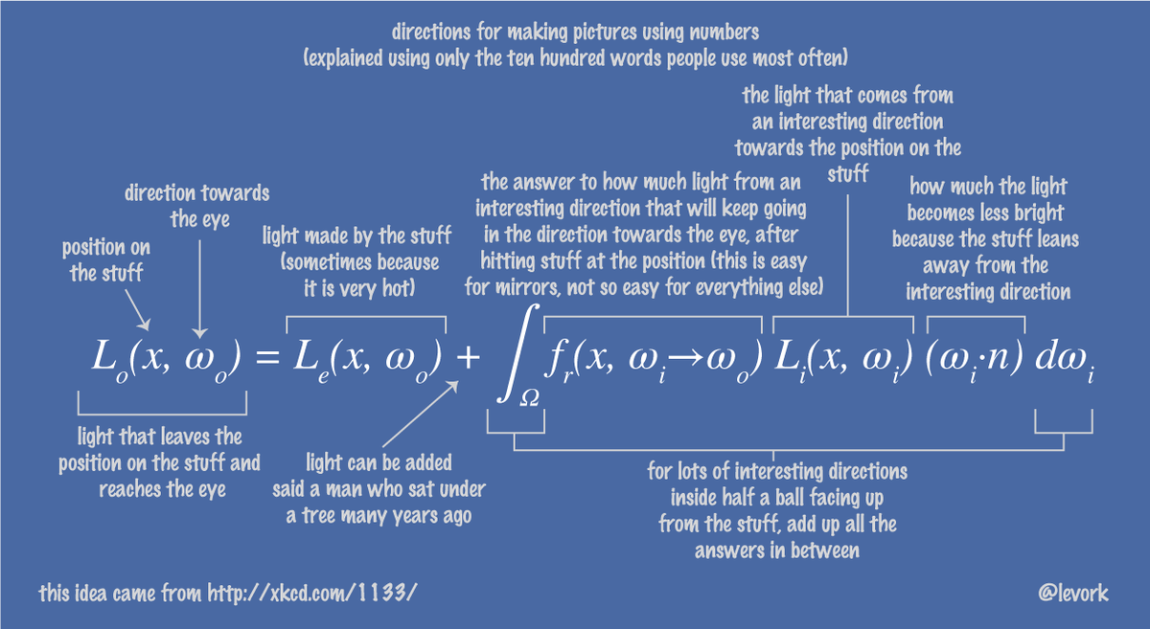
The rendering equation

Slide 7
The rendering equation
In real-time graphics
This is inefficient
We always use approximations

Slide 8
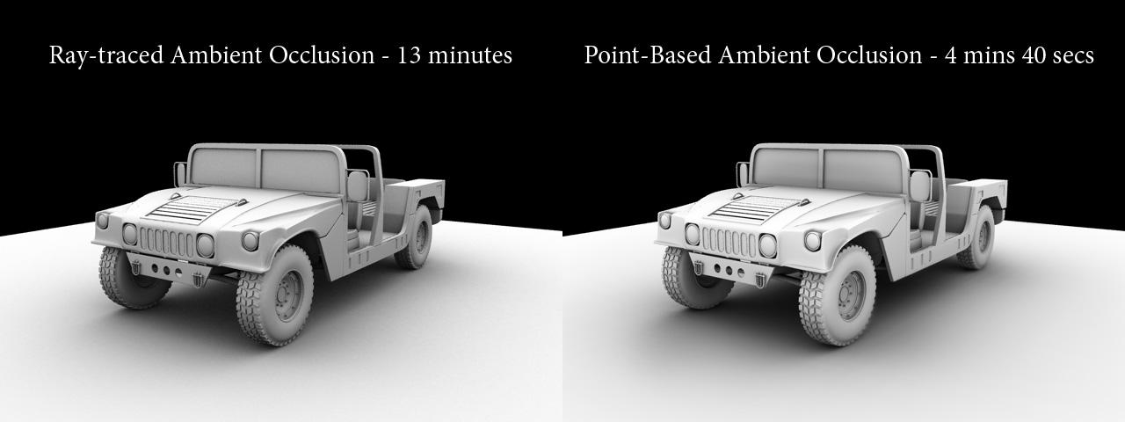
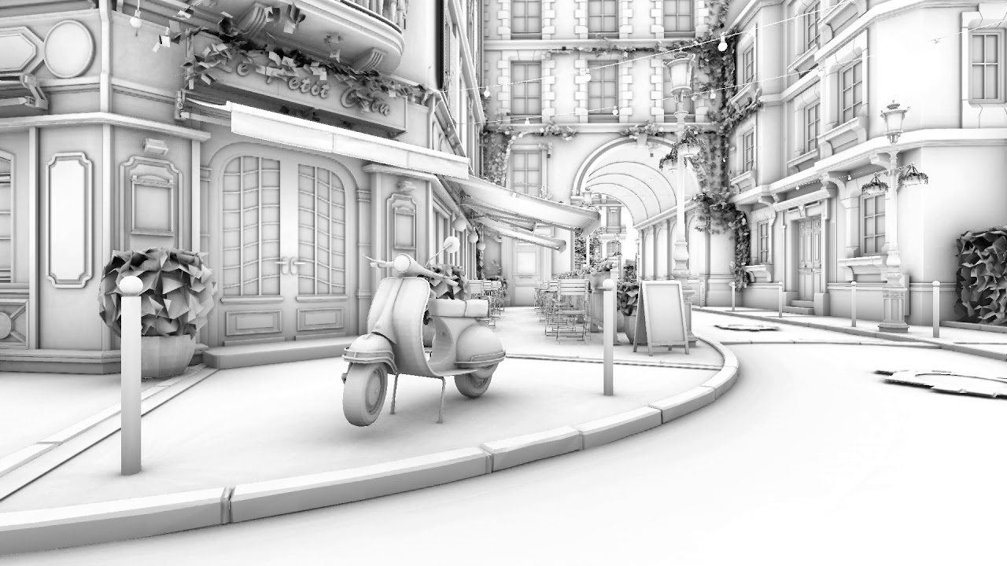
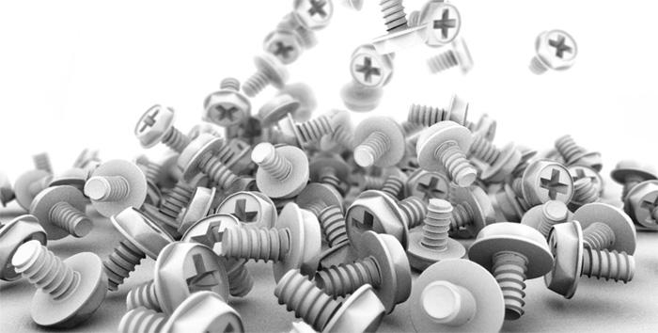
AO: Non real-time approaches
Better quality / slower...

Slide 9
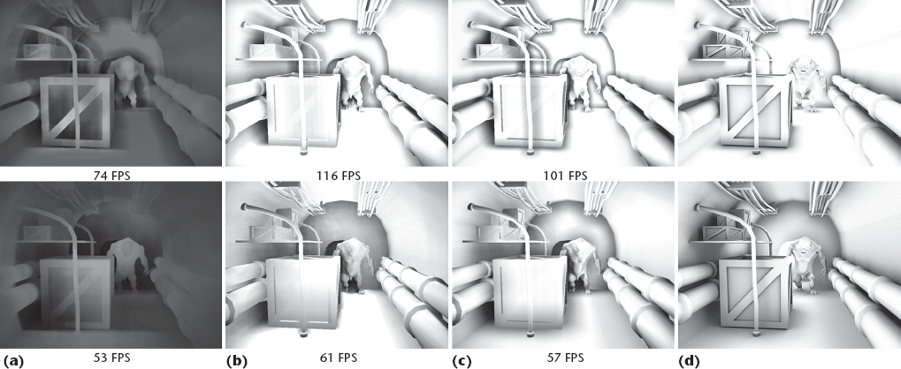
AO: Real-time approaches

Slide 10
SSAO Overview
Post-processing fragment shader
Inputs
Screen-filling quad
Depth buffer texture
Normal map texture
Others
Algorithm idea
Query neighbouring texels to measure occlusion
Output
Texture with the ambient occlusion term

Slide 11
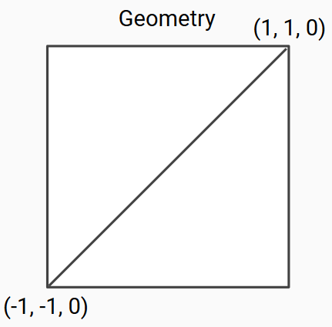
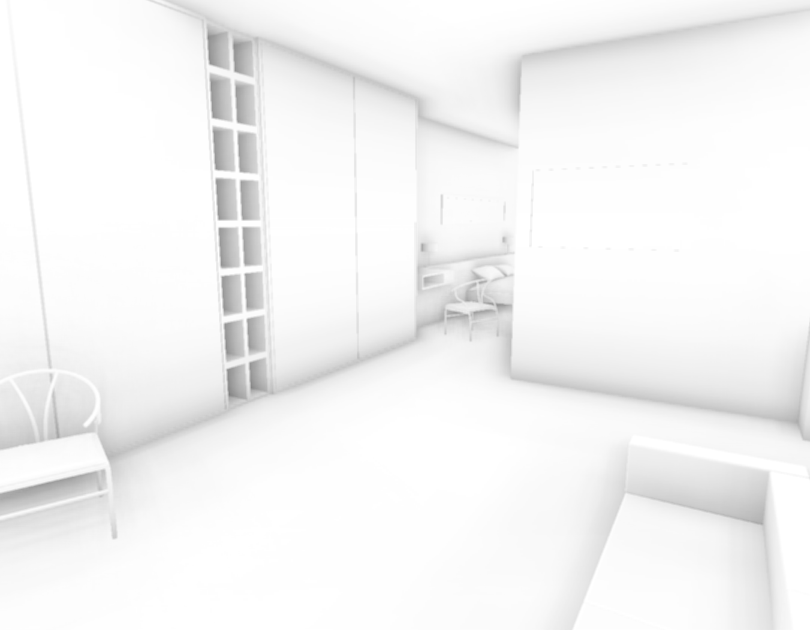
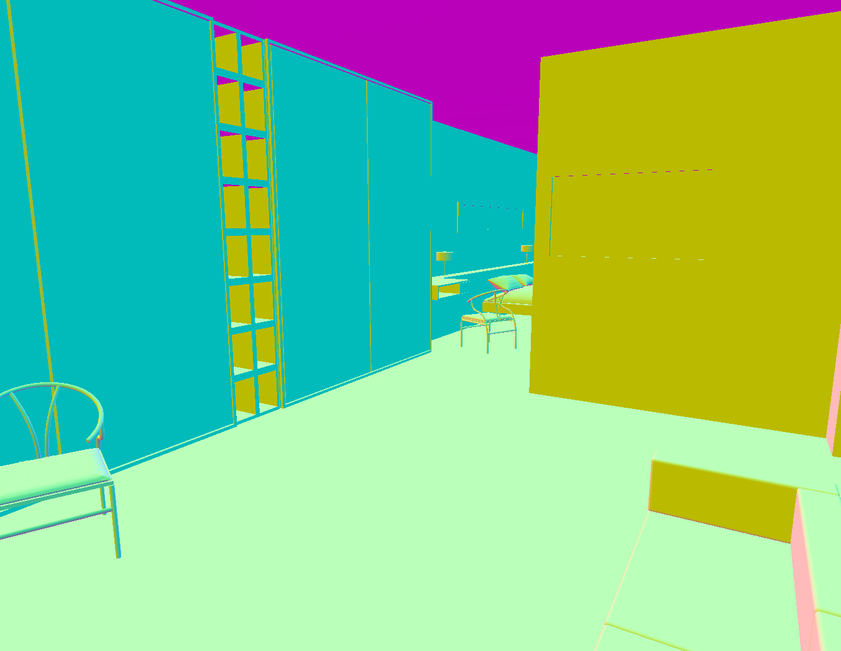
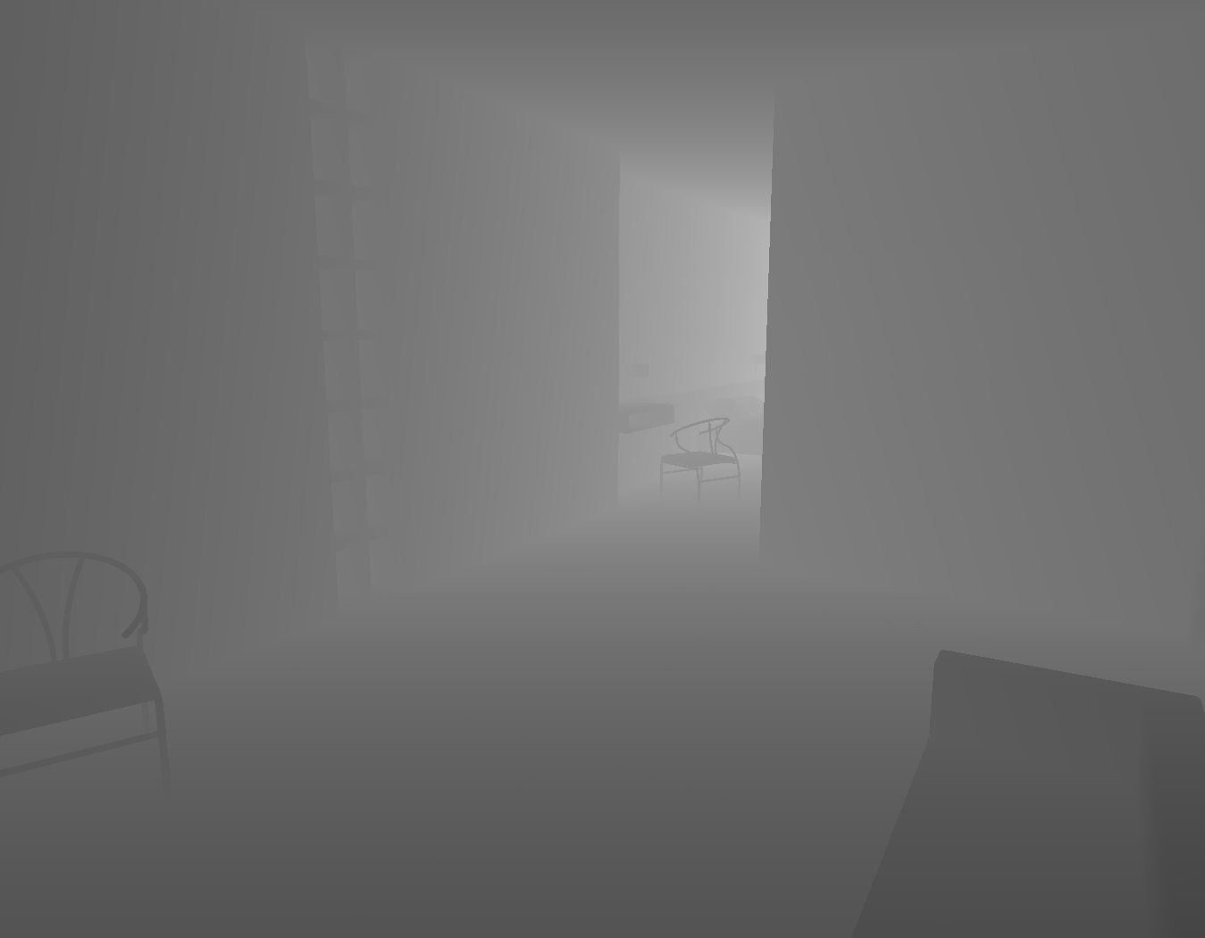
SSAO Overview
Vertex shader
Fragment shader
Viewport / Camera parameters
SSAO Fragment Shader
Screen-filling quad
No transformations
NDC coordinates
[-1, 1]

Slide 12
SSAO Overview
Vertex shader
Fragment shader
Viewport / Camera parameters
Neighbour samples
SSAO Fragment Shader
Screen-filling quad
No transformations
NDC coordinates
[-1, 1]

Slide 13
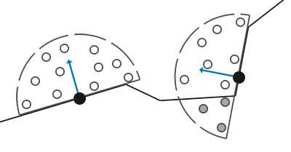
Generation of random samples in C++
Sample positions in tangent space
std::uniform_real_distribution<float> randomFloats(0.0, 1.0);
std::default_random_engine generator;
std::vector<glm::vec3> ssaoKernel;
for (unsigned int i = 0; i < 64; ++i)
{
glm::vec3 sample(
randomFloats(generator) * 2.0 - 1.0,
randomFloats(generator) * 2.0 - 1.0,
randomFloats(generator)
);
sample = glm::normalize(sample);
sample *= randomFloats(generator);
ssaoKernel.push_back(sample);
}

Slide 14
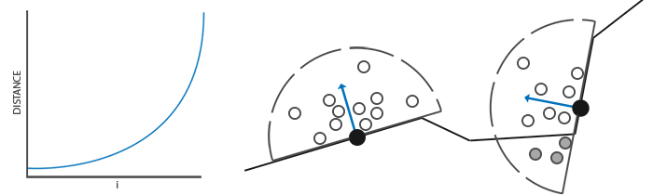
Generation of random samples in C++
Sample positions in tangent space
std::uniform_real_distribution<float> randomFloats(0.0, 1.0);
std::default_random_engine generator;
std::vector<glm::vec3> ssaoKernel;
for (unsigned int i = 0; i < 64; ++i)
{
glm::vec3 sample(
randomFloats(generator) * 2.0 - 1.0,
randomFloats(generator) * 2.0 - 1.0,
randomFloats(generator)
);
sample = glm::normalize(sample);
sample *= randomFloats(generator);
float scale = (float)i / 64.0;
scale = lerp(0.1f, 1.0f, scale * scale);
sample *= scale;
ssaoKernel.push_back(sample);
}

Slide 15
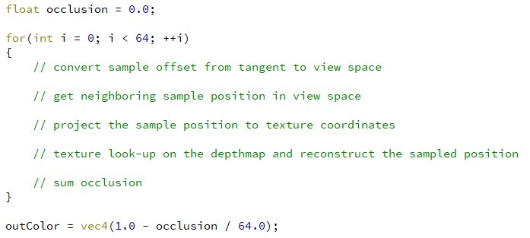
SSAO shader
Loop through the random samples
use a TBN matrix!
We have the normal, we can invent the tangent and bitangent
Several methods…
Un-project from depth map
Buffer with per-fragment positions (waste of vram...)

Slide 16
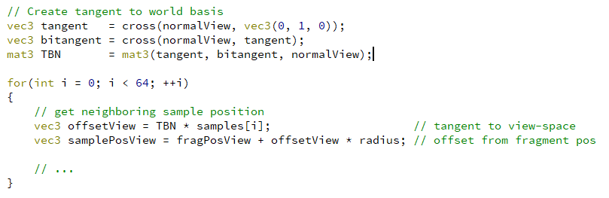
SSAO shader
Convert sample offsets from tangent to view space
Obtain neighbouring sample positions in view space

Slide 17
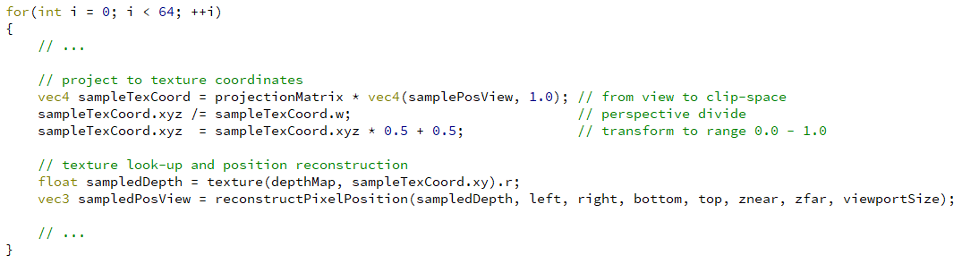
SSAO shader
Project neighbouring sample to texture coordinates
Query depth texture and reconstruct pixel position in view space

Slide 18
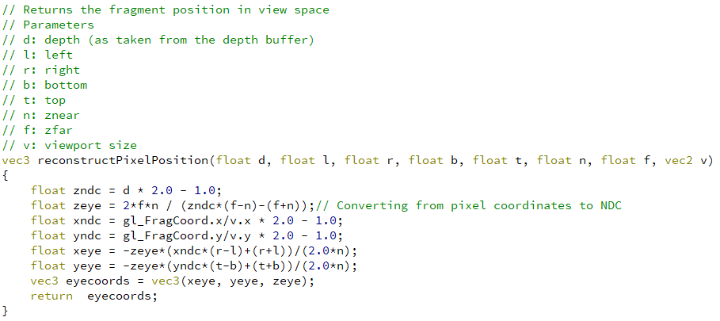
SSAO shader

Slide 19
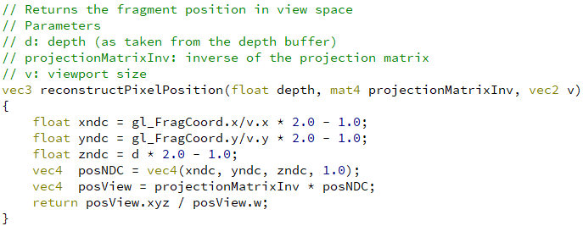
SSAO shader

Slide 20
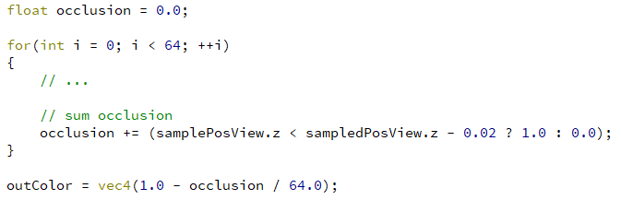
SSAO shader
Accumulate occlusion
Eye / camera
-z
sampledPosView
samplePosView

Slide 21
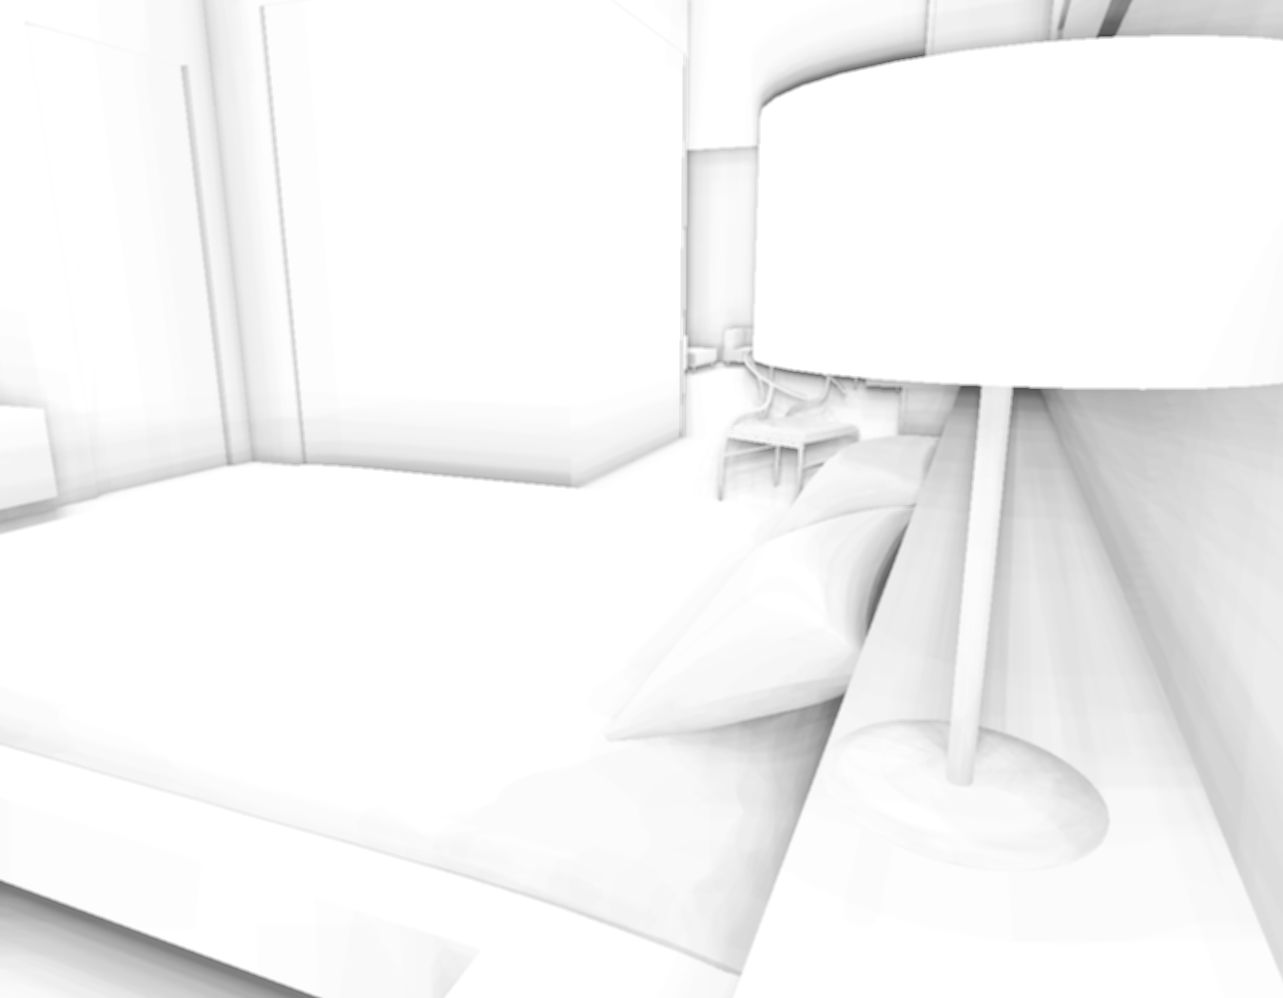
Artifacts
Banding patterns
Occlusion of distant objects

Slide 22
Artifacts
Banding patterns
Occlusion of distant objects

Slide 23
Artifacts
Banding patterns
Occlusion of distant objects

Slide 24
Artifacts
Banding patterns

Slide 25
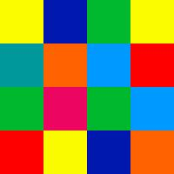
Artifacts
Vertex shader
Fragment shader
Viewport / Camera parameters
Neighbour samples
Rotation vectors
SSAO Fragment Shader
Screen-filling quad
No transformations
NDC coordinates
[-1, 1]

Slide 26
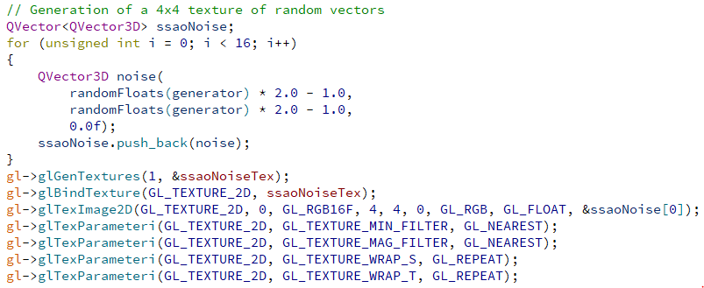
Artifacts
4x4 texture of random vectors

Slide 27
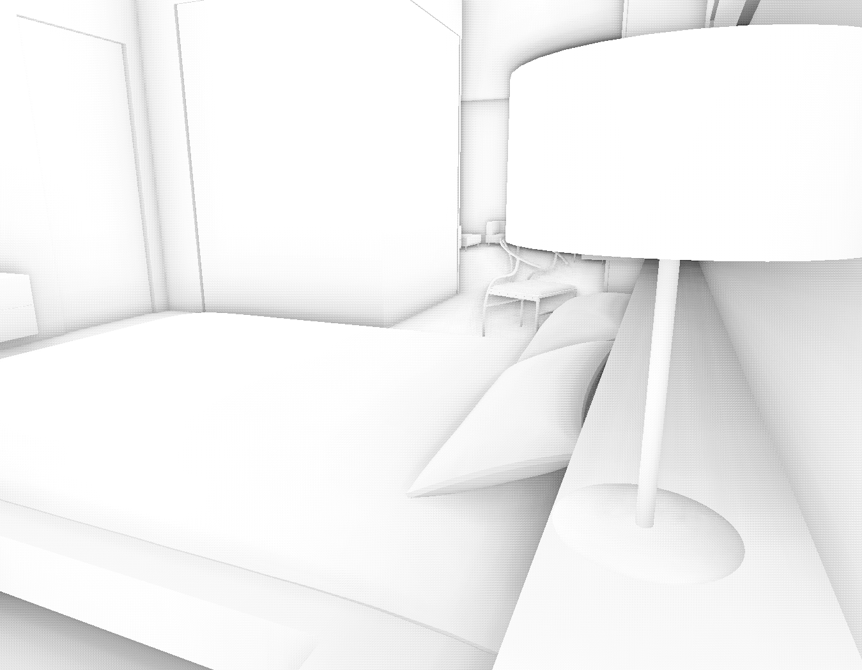
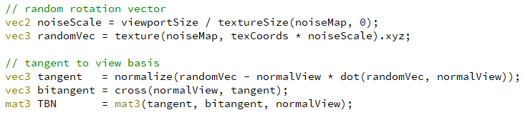
Artifacts
Banding patterns
Remove patterns introducing noise
4x4 texture of random rotation vectors (per-pixel)
Modify the orientation of TBN around the normal (z axis) using the random vector.

Slide 28

Artifacts
Banding patterns
Remove patterns introducing noise
4x4 texture of random vectors (per-pixel)
Modify the orientation of TBN around the normal (z axis) using the random vector.
Extra 4x4 blur pass to remove noise.

Slide 29
Artifacts
Occlusion of distant objects

Slide 30
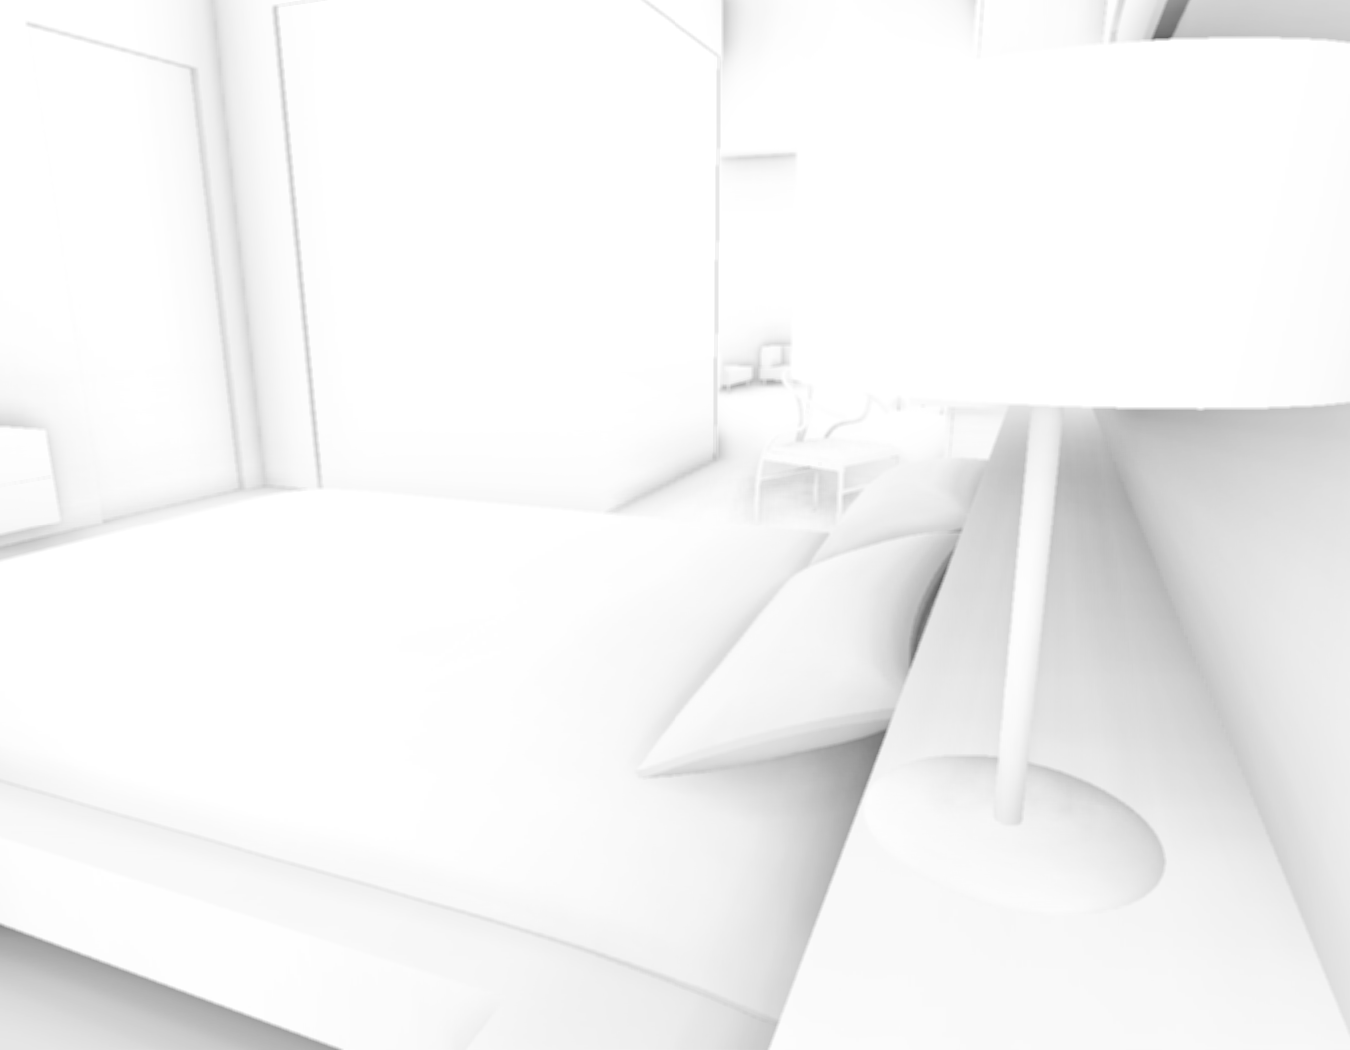
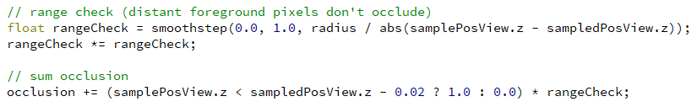
Artifacts
Occlusion of distant objects
occlusion
bias
0 radius
distance
bias

Slide 31
Recap
Vertex shader
Fragment shader
Viewport / Camera parameters
Neighbour samples
Rotation vectors
SSAO Fragment Shader
Screen-filling quad
No transformations
NDC coordinates
[-1, 1]

Slide 32
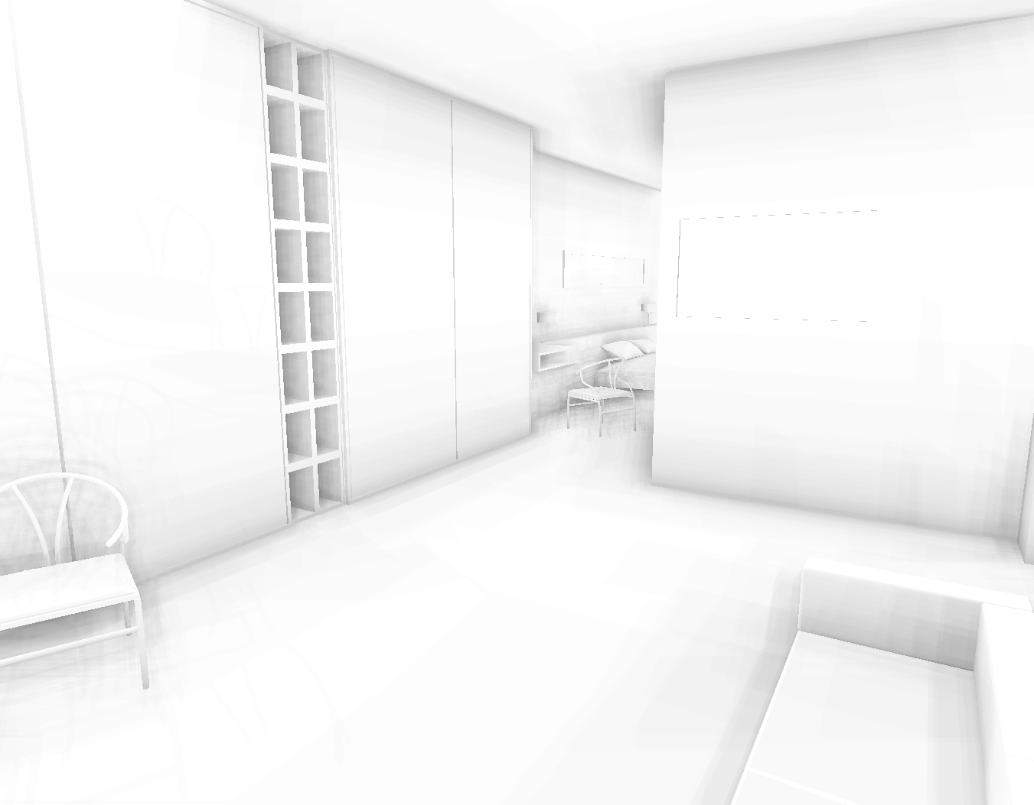
Recap

Slide 33

Recap

Slide 34
Recap

Slide 35
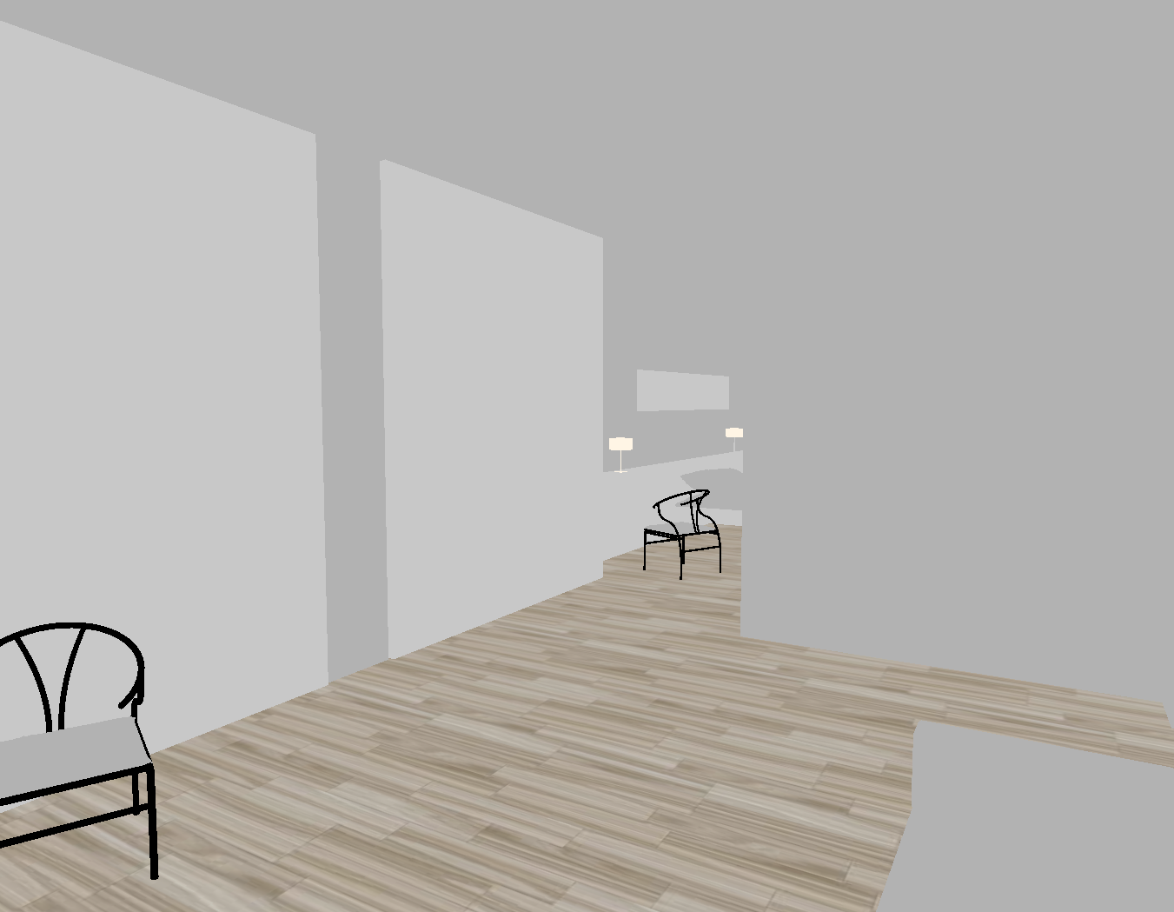
Recap

Slide 36
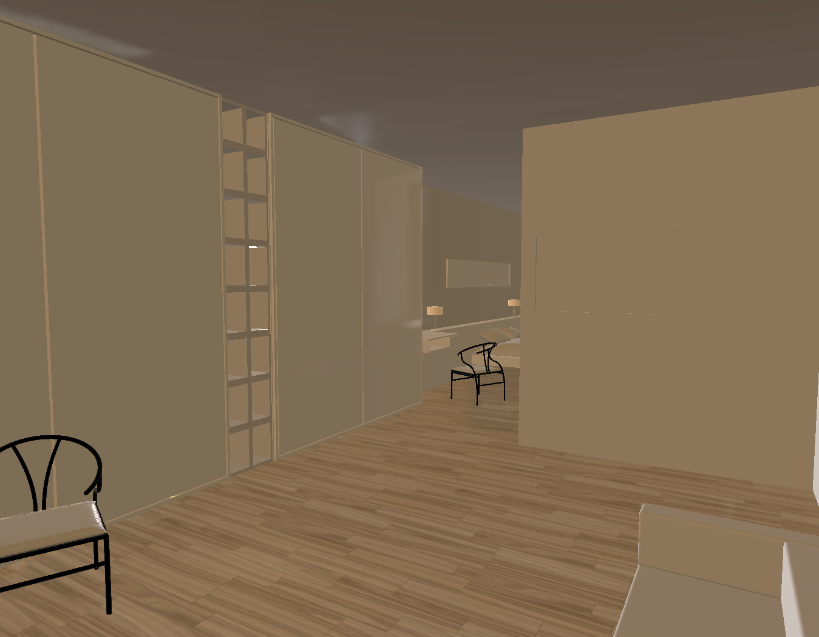
Recap

Slide 37
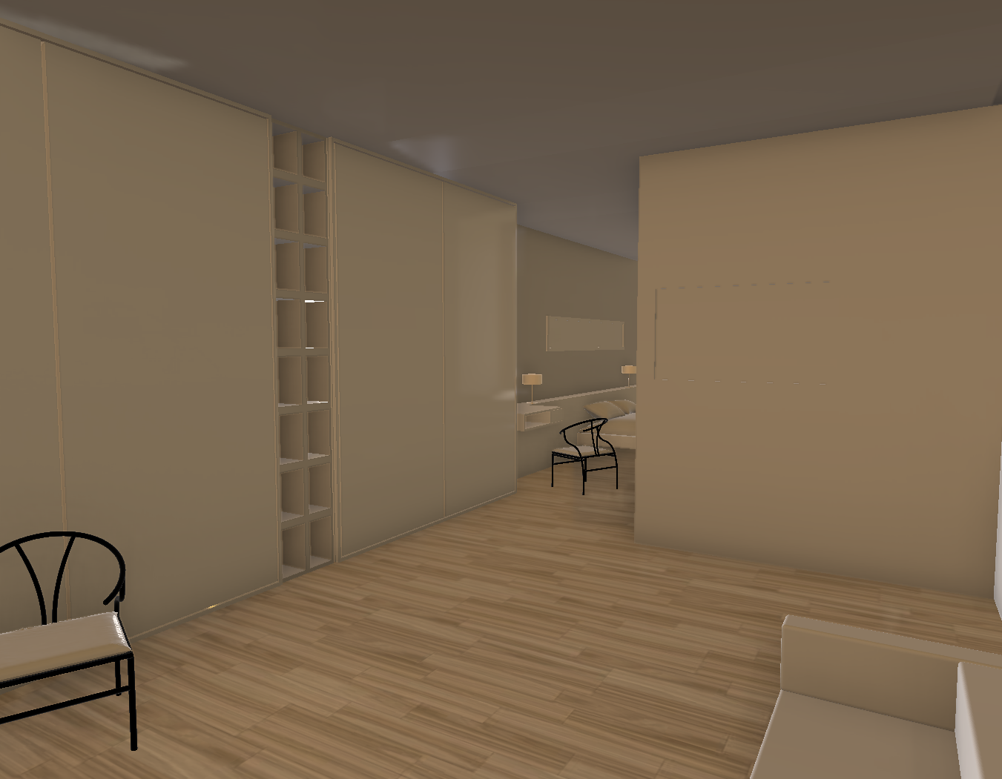
Recap

Slide 38
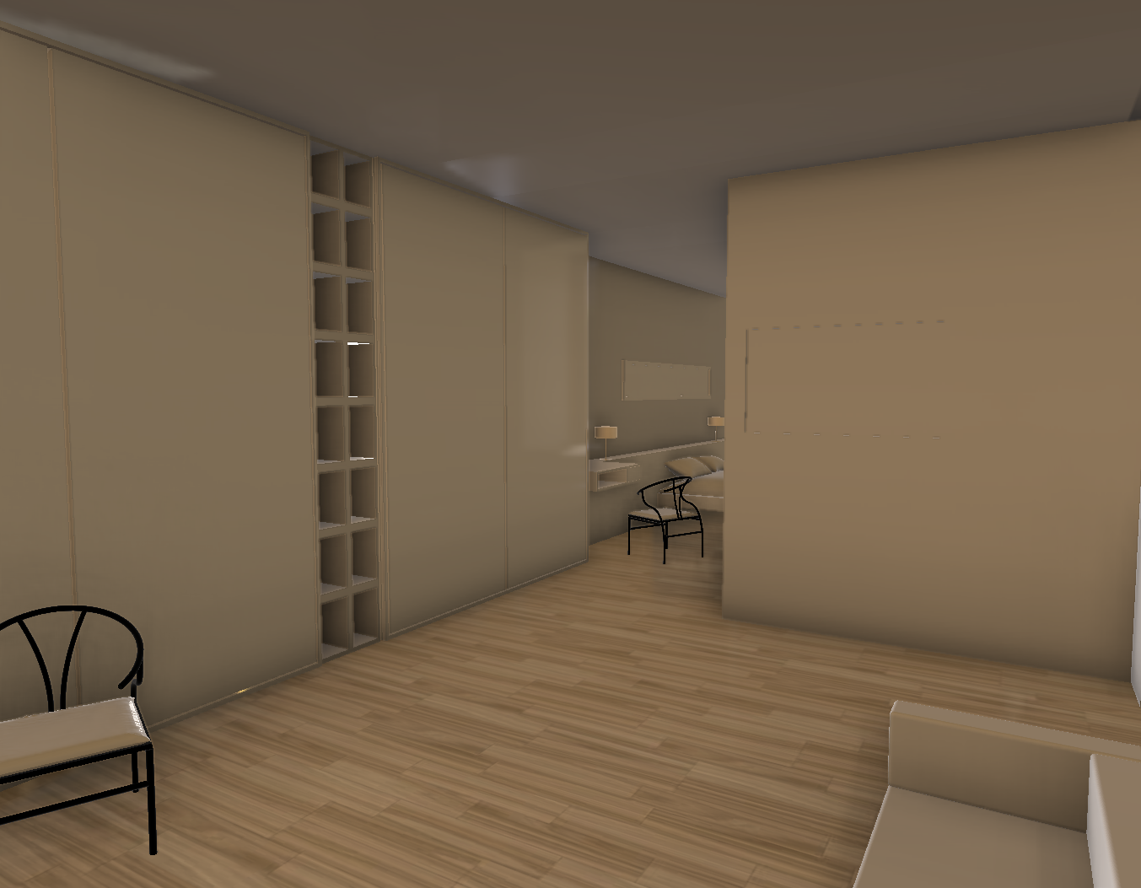
Recap

Slide 39
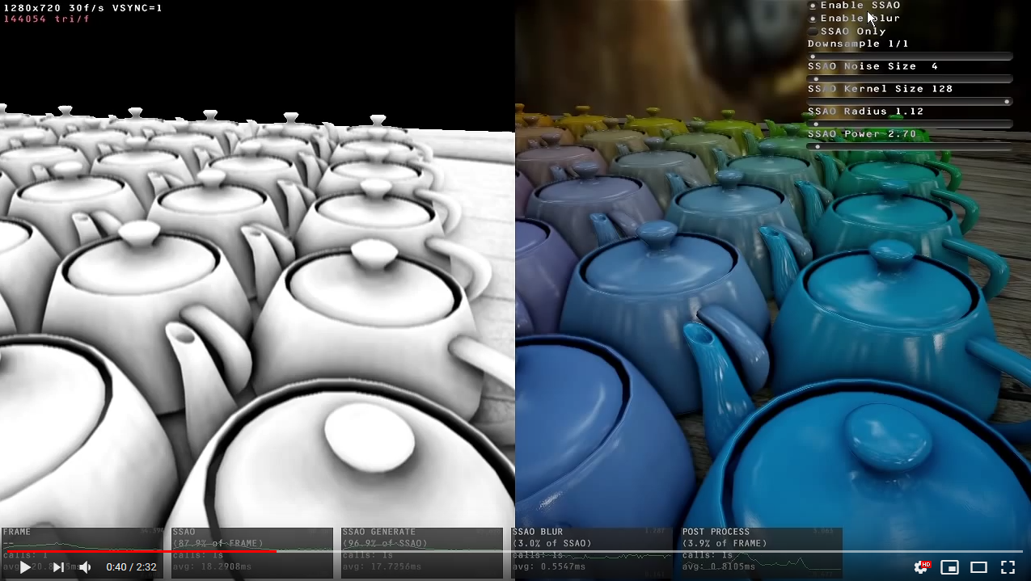
Video

Slide 40
References
SSAO tutorials
http://john-chapman-graphics.blogspot.com/2013/01/ssao-tutorial.html
https://learnopengl.com/Advanced-Lighting/SSAO
http://ogldev.atspace.co.uk/www/tutorial46/tutorial46.html
Analysis of several SSAO techniques:
https://vr.arvilab.com/blog/ambient-occlusion
Common SSAO artifacts:
https://mtnphil.wordpress.com/2013/06/26/know-your-ssao-artifacts/

Slide 41

Questions?

